Slide 1
Sales & Profitability
Analysis
Sales performance, profitability, and
key business opportunities
Brad M. / Power BI Project
2019–June 2022

Slide 2
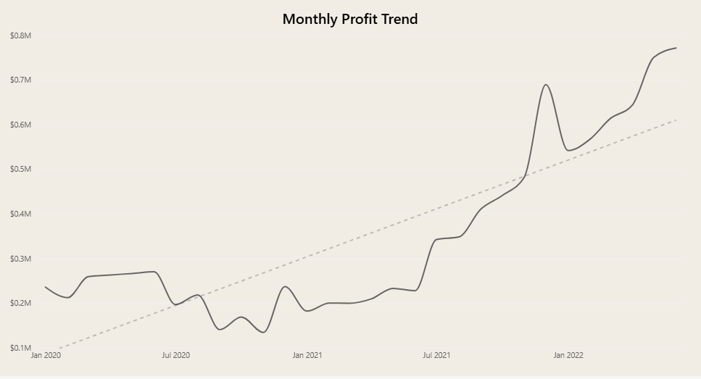
Business Objective & Performance Overview
Business Objective:
Evaluate the drivers of sales and profitability to identify opportunities for better business performance.
$24.9M
$10.5M
Revenue
Profit
25.2K
$415.58
Orders
Average profit
per order

Slide 3
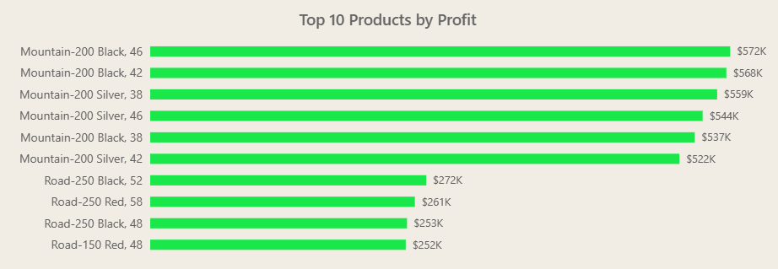
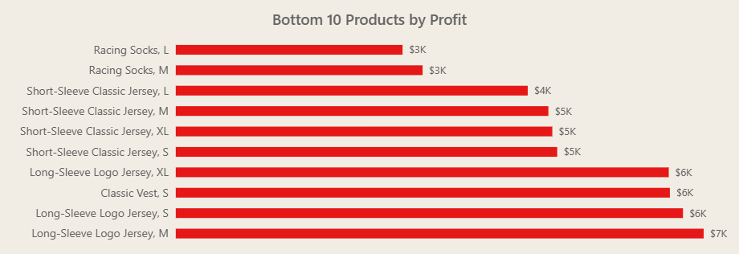
Product Performance
Highest-profit products
Lowest-profit products
Bikes dominate the highest-profit rankings. Mountain-200 variants hold the top six positions.
Clothing dominates the lowest-profit rankings. Racing socks earn the least profit, while jersey products account for most of the remaining positions
Sales volume and profit margin need further analysis to identify the drivers of these differences.

Slide 4
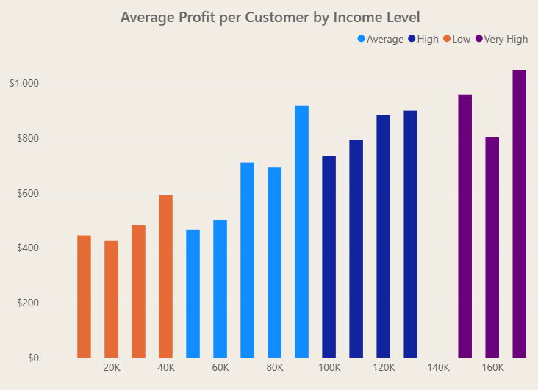
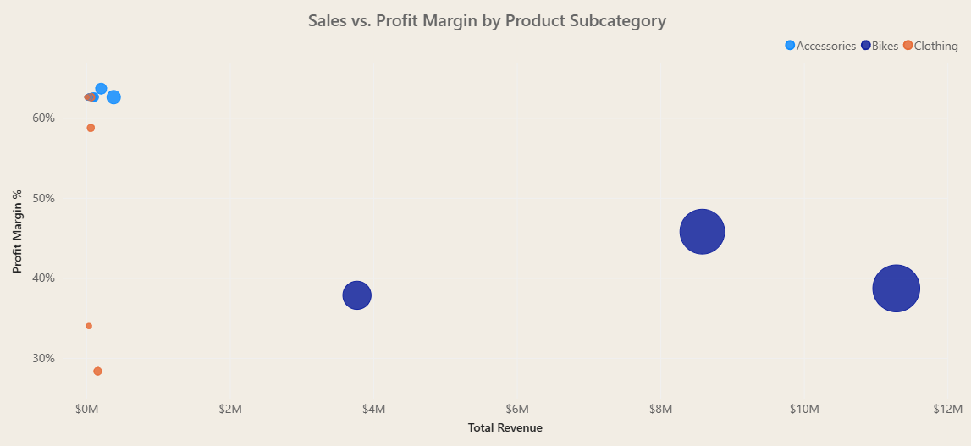
Profitability Opportunities
Customer income
Revenue and profit margin
Average profit per customer generally rises with income and peaks in the highest-income segment.
Bikes generate much more revenue, while several smaller accessory and clothing subcategories earn higher margins.
Growth opportunity: investigate high-margin, lower-revenue non-bike subcategories.

Slide 5
Recommendations & Next Steps
PRIORITY
NEXT STEP
1
Growth opportunities
Test targeted promotions and measure results.
High-margin non-bike products may offer untapped growth.
2
Core bike business
Analyze pricing, costs, inventory and demand for high-profit bike products.
Protect and optimize high-profit bike products.
3
Customer targeting
Analyze customer behavior and test targeted campaigns.
Investigate how higher-income customers buy.

Slide 6
Thank You
Sales & Profitability Analysis
Data
Analysis
Action

